Slide 1

Quit Smoking Support Application
Student Name: Bilal Boulaalam (ID: 20213111)
Partner Name: Abdulmuhsen Alzouba (ID: 20215679)

Slide 2

The Challenge of Smoking Addiction
The Problem
Why Quitting Is Hard
Our Solution
Smoking is a harmful addiction that significantly impacts both physical and mental health. Millions of people struggle daily with this dependency, experiencing severe health consequences and reduced quality of life.
Many smokers desperately want to quit but face overwhelming challenges from cravings, deeply ingrained habits, and lack of consistent support systems. Traditional methods often leave users feeling isolated.
This project delivers comprehensive digital support designed to empower users throughout their quit-smoking journey, providing the tools and motivation they need to succeed.

Slide 3




Core Problem & Objectives
Problem Statement
Project Goals
Target Audience
Quitting smoking without proper guidance leads to high failure rates. Lack of motivation and inadequate support systems cause frequent relapses among those attempting to quit.
Help users quit smoking successfully
Smokers ready to quit
People reducing consumption
Track smoke-free progress daily
Users seeking habit tracking
Reduce cravings through interactive tools
Anyone needing motivation
Provide ongoing motivation

Slide 4


System Architecture & Design
1
2
Web-Based Platform
Cross-Platform Compatible
Fully responsive web application accessible from any device, providing flexibility and convenience for users wherever they are.
Works seamlessly on both mobile devices and desktop computers, ensuring consistent experience across all screen sizes.
3
4
Local Storage System
Offline-Friendly
Uses browser local storage to securely save user data, eliminating the need for constant internet connectivity.
Designed to function without internet access, making it reliable even in areas with poor connectivity.

Slide 5
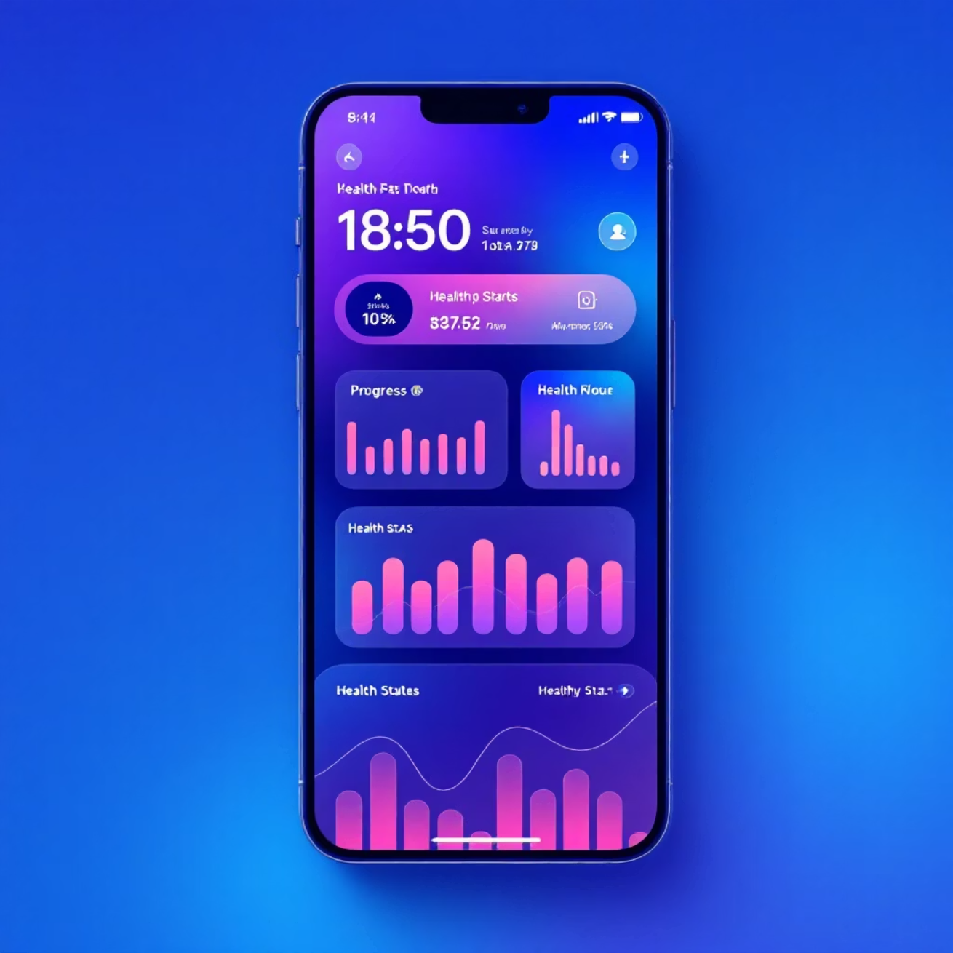
Dashboard: Your Progress Hub
The dashboard serves as the central command center for tracking your quit-smoking journey, providing real-time insights and motivation to keep you on track.
Smoke-Free Time Tracking
See exactly how long you've been smoke-free in days, hours, and minutes
Financial Savings
Calculate money saved by not buying cigarettes
Health Improvements
View timeline of physical health benefits as your body recovers
Daily Motivation
Receive inspiring quotes and maintain your streak counter

Slide 6
Comprehensive Tools Suite
Breathing Relaxation
Craving Management
Guided breathing exercises to calm cravings and reduce anxiety during difficult moments.
Specialized tools designed to help users navigate and overcome intense cigarette cravings.
Stress Relief
Sleep & Water Tracking
Effective techniques for managing stress without resorting to smoking as a coping mechanism.
Monitor healthy habits that support recovery and improve overall well-being during the quit process.
Personal Journal
Trigger Identification
Document your journey, track emotions, and reflect on progress and challenges along the way.
Identify and understand personal smoking triggers to develop effective avoidance strategies.

Slide 7
Interactive Mini-Games for Distraction
When cravings hit, our engaging mini-games provide healthy distraction and help retrain your brain's reward system away from smoking.
🎯 Tap-to-Destroy
🌬️ Breathing Game
Tap cigarettes to destroy them in this satisfying stress-relief game
Follow guided breathing patterns for instant relaxation
🧩 Puzzle Blocks
🧠 Memory Match
Challenge your mind and occupy your hands with strategic puzzles
Improve focus while keeping your mind off cravings
⚡ Reaction Speed
💆 Stress Ball
Quick-reflex game to boost mood and energy
Virtual stress relief at your fingertips anytime, anywhere

Slide 8


Motivation System: Stay Inspired
Continuous Encouragement
Our motivation system keeps you inspired with:
50 Motivational Quotes: Random inspiring messages displayed on each login to start your day positively
50 Success Stories: Real experiences from ex-smokers who successfully quit, proving it's possible
Achievement Badges: Unlock rewards for reaching milestones and maintaining streaks
Daily Messages: Personalized encouragement delivered every day to reinforce your commitment
Research shows: Regular positive reinforcement significantly increases quit success rates and reduces relapse probability.

Slide 9



User Experience & Benefits
Clean Interface
Mobile-Responsive
Real Results
Modern, intuitive design with light and dark modes for comfortable viewing anytime
Seamless experience across all devices with easy navigation and touch-friendly controls
Helps users stay smoke-free, reduces cravings effectively, and encourages lasting healthy habits
Key Challenges Addressed
Managing Cravings
Long-Term Motivation
Continued Engagement
Providing instant tools and distractions when cravings strike most intensely
Sustaining user engagement through varied content and achievement systems
Keeping users active and committed throughout their entire quit journey

Slide 10

Conclusion & Future Vision
A Complete Support System for Quitting Smoking
This application combines comprehensive tracking, practical tools, engaging games, and continuous motivation into one powerful platform designed for long-term success.
01
02
Current Achievement
Future Enhancements
A practical, functional solution that addresses the real challenges smokers face when quitting
User accounts with cloud sync, AI-based quitting assistant, community chat features, and personalized quitting plans
03
Ultimate Goal
Empower every user to achieve a smoke-free life through technology, support, and proven behavioral strategies

